Slide 1
YOLO Text Recognition

Slide 2
Response of ChatGPT on YOLO for Recognition:
YOLO (You Only Look Once) is primarily designed for object detection, not for word level recognition. YOLO takes an image as input and returns the bounding boxes of objects along with their class labels. It does not have the capability to recognize individual words or characters.
Text recognition is a more complex task than object detection, it requires a model to understand the structure of text and to recognize individual characters and words. YOLO is not designed to perform this type of task, and it is not able to recognize individual words.
Instead, models specifically designed for text recognition, such as CNN- or RNN-based models, are generally better suited for this task and can achieve higher accuracy in recognizing individual words or characters.

Slide 3
Use of YOLO in Existing Projects
We went through lot of research papers and projects based on OCR or projects in which YOLO is used, and we could clearly see that YOLO was always used in combination with a OCR engine model.
In OCR projects, YOLO is often used to detect the bounding boxes of text regions in an image. These bounding boxes can then be used as input for a separate text recognition model, such as a CNN or RNN based OCR engine, to recognize individual characters and words.
In OCR projects, YOLO is always used in combination with text recognition models to create a pipeline that can detect and recognize text in images. YOLO is used to detect the bounding boxes of text regions and the text recognition model is used to recognize the individual characters and words within those regions.

Slide 4
Examples of YOLO in Existing Projects
“TextBoxes: A Fast Text Detector with a Single Deep Neural Network" (https://arxiv.org/abs/1611.06779)
This paper describes a text detection method based on YOLO and a CNN-based text recognition model. The YOLO model is used to detect the bounding boxes of text regions and the CNN-based model is used to recognize the text within those regions.
"Real-time Text Detection in Natural Images with Connectionist Text Proposal Network" (https://arxiv.org/abs/1707.01926)
This paper describes a text detection method based on YOLO and a CRNN-based text recognition model. The YOLO model is used to detect text regions in an image and the CRNN-based model is used to recognize the text within those regions.

Slide 5
Use of YOLO in Existing Projects
"FOTS: Fast Oriented Text Spotting with a Unified Network" (https://arxiv.org/abs/1703.09789)
This paper describes a text detection method based on YOLO and a CNN-based text recognition model. The YOLO model is used to detect the bounding boxes of text regions and the CNN-based model is used to recognize the text within those regions.
"Robust Scene Text Detection with Convolutional Neural Networks" (https://arxiv.org/abs/1609.03605)
This paper describes a text detection method based on YOLO and a CNN-based text recognition model. The YOLO model is used to detect the bounding boxes of text regions in an image and the CNN-based model is used to recognize the text within those regions.

Slide 6
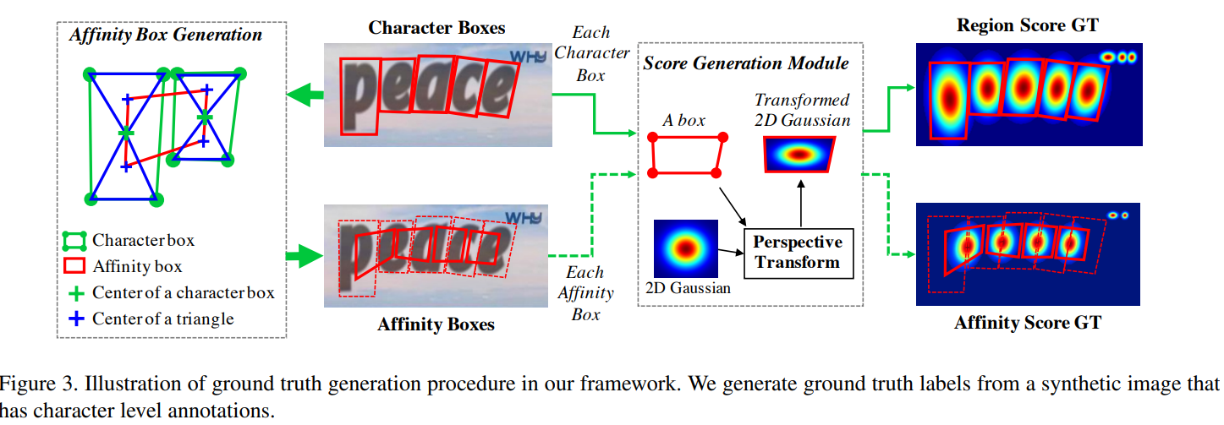
CRAFT Model
Notes:
For each training image, we generate the ground truth label for the region score and the affinity score with characterlevel bounding boxes. The region score represents the probability that the given pixel is the center of the character, and the affinity score represents the center probability of the space between adjacent characters. Unlike a binary segmentation map, which labels each pixel discretely, we encode the probability of the character center with a Gaussian heatmap. This heatmap representation has been used in other applications, such as in pose estimation works [1, 29] due to its high flexibility when dealing with ground truth regions that are not rigidly bounded. We use the heatmap representation to learn both the region score and the affinity score. Fig. 3 summarizes the label generation pipeline for a synthetic image. Computing the Gaussian distribution value directly for each pixel within the bounding box is very time consuming. Since character bounding boxes on an image are generally distorted via perspective projections, we use the following steps to approximate and generate the ground truth for both the region score and the affinity score: 1) prepare a 2-dimensional isotropic Gaussian map; 2) compute perspective transform between the Gaussian map region and each character box; 3) warp Gaussian map to the box area. For the ground truths of the affinity score, the affinity boxes are defined using adjacent character boxes, as shown in Fig. 3. By drawing diagonal lines to connect opposite corners of each character box, we can generate two triangles – which we will refer to as the upper and lower character triangles. Then, for each adjacent character box pair, an affinity box is generated by setting the centers of the upper and lower triangles as corners of the box.

Slide 7
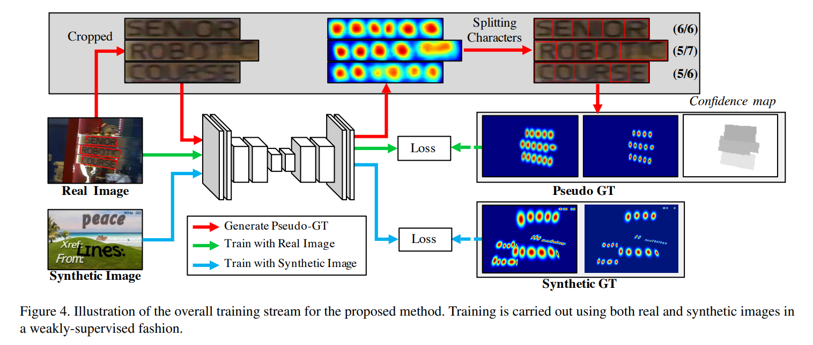
CRAFT Model Training

Slide 8
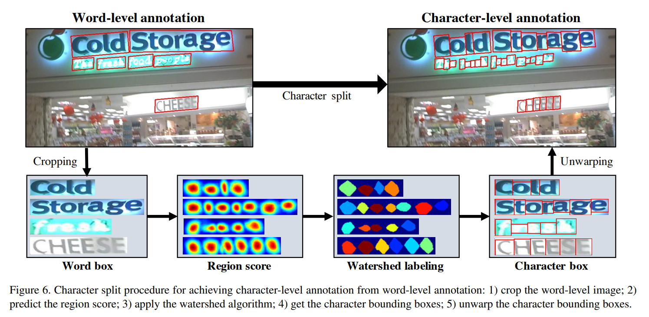
CRAFT character split procedure

Slide 9
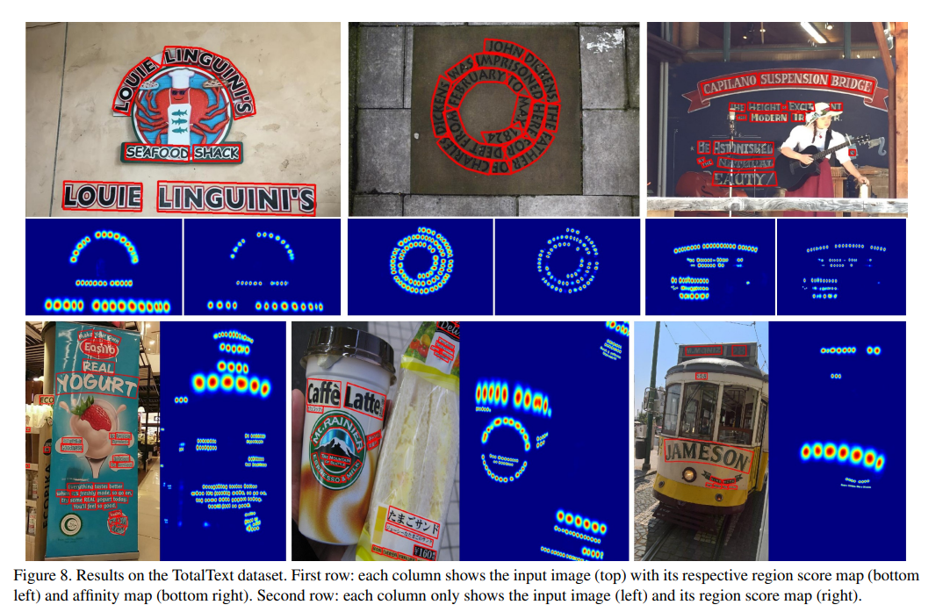
CRAFT Text detection with score maps

Slide 10
Why OCR models over YOLO?
YOLO is primarily designed for object detection and not specifically for text recognition. Models specifically designed for text recognition, such as CNN- or RNN-based models, are generally better suited for this task and can achieve higher accuracy.
Text recognition requires high-resolution images and detailed information about the structure of the text, which YOLO may not be able to provide.
YOLO is a real-time object detection system and it may not be able to process images fast enough for real-time text recognition in some applications.

Slide 11
Why OCR models over YOLO?
YOLO may not be able to handle text that is small or has low resolution, this can make it difficult for the model to detect and recognize text in certain images.
YOLO models are not designed to handle the variations in font and styles of text, which can affect the accuracy of text recognition.
Using YOLO we might be able to detect it’s a text but we won’t be able to recognize the text, for that we will require an OCR Model on top of that. If we are doing character level annotations, we will be able to detect and recognize those characters but there will be a problem to merge these numbers to form a single valued number.
This problem can be solved by using coordinates of the digits and then merging based on it, but then the project’s scope will be limited to only one screen or display, as several units have different types of display screen thus having different spaces between the digits, which thereby will have different coordinates and threshold(minimum distance upon which we can specify whether the digit is near to a number a or number b).

Slide 12
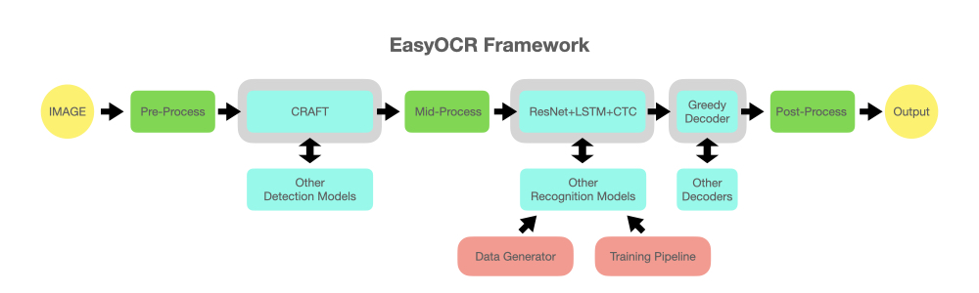
Working of EasyOCR

Slide 13
Working of EasyOCR
Once the text regions are identified, EasyOCR uses a text recognition algorithm to extract the text from the image. The text recognition algorithm is based on the CRNN model, which is a combination of a CNN and an RNN. The CNN is used to extract features from the image, and the RNN is used to recognize the text based on those features.
The recognized text is then passed through post-processing steps such as spell-checking and grammar correction. This helps to improve the accuracy of the recognized text.
EasyOCR is trained on a large dataset of images, which helps to improve its accuracy. EasyOCR is a very powerful OCR model and it performs well on a wide variety of images, including images with low resolution, text with different orientations, and text in different languages.

